Slide 1
7COM1025 Programming for Software Engineers
7COM1025 Programming for Software Engineers
UML diagram, Testing and Debugging, Defensive Programming, Exceptions
Dr Hui Cheng
Email: h.cheng2@herts.ac.uk

Slide 2

UML (Unified Modeling Language)
Notes:
Unified Modeling Language

Slide 3
What is modeling?
Modeling consists of building an abstraction of reality.
Abstractions are simplifications because:
They ignore irrelevant details and
They only represent the relevant details.
What is relevant or irrelevant?
depending on the purpose of the model.

Slide 4
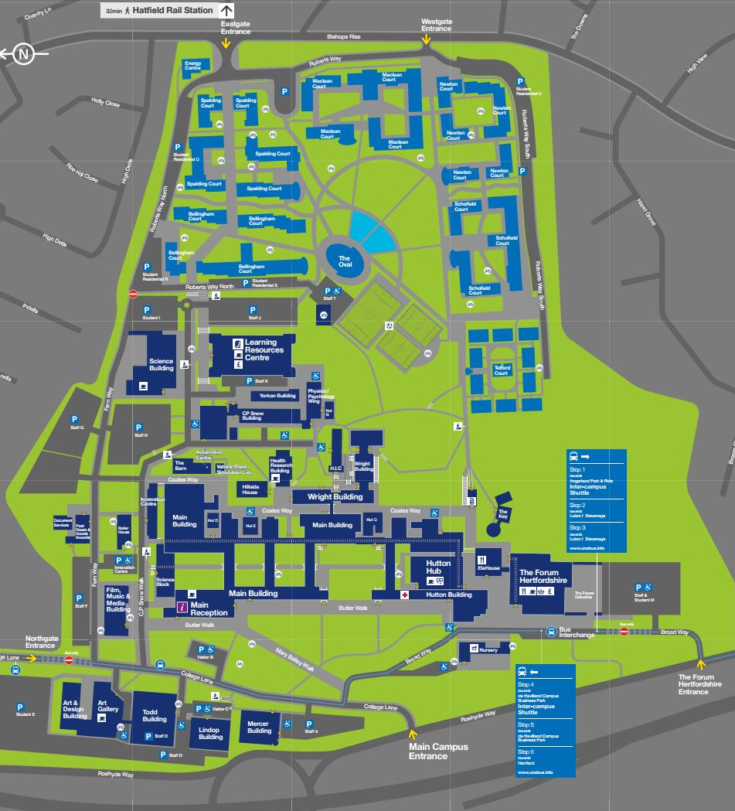
Example: campus map

Slide 5
Why model software?
Software is getting increasingly more complex
Windows XP (2001) > 40 million lines of code
A single programmer cannot manage this amount of code in its entirety.
Code is not easily understandable by developers who did not write it
We need simpler representations for complex systems
Modeling is a mean for dealing with complexity

Slide 6
Concepts and Phenomena
Phenomenon
An object in the world of a domain as you perceive it
Example: The lecture you are attending
Example: Your apple watch
Concept
Describes the properties of phenomena that are common.
Example: Lectures
Example: watch
Concept is a 3-tuple:
Name (To distinguish it from other concepts)
Purpose (Properties that determine if a phenomenon is a member of a concept)
Members (The set of phenomena which are part of the concept)

Slide 7
Concepts and phenomena
Members
Name
Purpose
Clock
A device that
measures time.
Abstraction
Classification of phenomena into concepts
Modeling
Development of abstractions to answer specific questions about a set of phenomena while ignoring irrelevant details.

Slide 8
What is UML?
UML (Unified Modeling Language)
An emerging standard for modeling object-oriented software.
Reference: “The Unified Modeling Language User Guide”, Addison Wesley, 1999.
…

Slide 9
Diagrams
Use case Diagrams
Describe the functional behavior of the system as seen by the user.
Functional model
Class diagrams
Describe the static structure of the system: Objects, Attributes, Associations
Object model
Sequence diagrams
Describe the dynamic behavior between actors and the system and between objects of the system
Dynamic model

Slide 10
UML Core Conventions
Rectangles are classes or instances
Ovals are functions or use cases
Instances are denoted with an underlined names
myWatch:SimpleWatch
Joe:Firefighter
Types are denoted with non underlined names
SimpleWatch
Firefighter
Diagrams are graphs
Nodes are entities
Arcs are relationships between entities

Slide 11
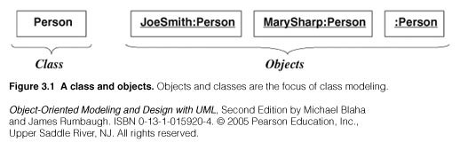
UML representation of classes/objects:
UML: Unified Modeling Language
Class/object representation

Slide 12
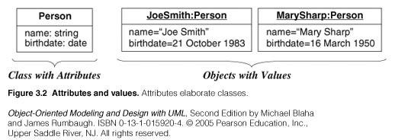
UML representation
Value : piece of data.
Attribute: a named property of a class that describes a value held by each object of the class.
Type is behind attribute, separated by colon

Slide 13
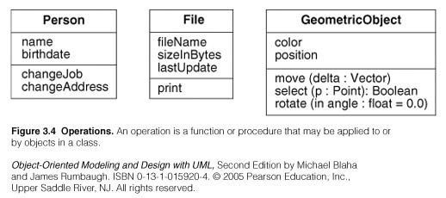
UML representation
An operation is a function or procedure that may be applied to or by objects in a class.
A method is the implementation of an operation for a class.

Slide 14
Relationships
7COM1025 Programming for Software Engineers
In UML, object interconnections (logical or physical), are modeled as relationships.
There are three kinds of relationships in UML:
dependencies
generalizations
associations

Slide 15
Dependency Relationships
7COM1025 Programming for Software Engineers
A dependency indicates a semantic relationship between two or
more elements. The dependency from CourseSchedule to Course exists because Course is used in both the add and remove operations of CourseSchedule.
CourseSchedule
Course
add(c : Course)
remove(c : Course)

Slide 16
Generalization Relationships
7COM1025 Programming for Software Engineers
Person
A generalization connects a subclass
to its superclass.
It denotes an inheritance of attributes and behavior from the superclass to the subclass and indicates a specialization in the subclass of the more general superclass.
Student

Slide 17
Generalization Relationships (Cont’d)
7COM1025 Programming for Software Engineers
UML permits a class to inherit from multiple superclasses, although some programming languages (e.g., Java) do not permit multiple inheritance.
Student
Employee
TeachingAssistant

Slide 18
Generalization/Inheritance
Often Generalization is called a “IS A” relationship
Generalization is the relationship between a class (superclass) and one or more variations of the class (subclasses).
Generalization organizes classes by their similarities and their differences, structuring the descriptions of objects.
A superclass holds common attributes, operations and associations.
The subclasses adds specific attributes, operations, and associations. They inherit the features of their superclass.
Simple generalization organizes classes into a hierarchy.
A subclass may override a superclass feature (attribute default values, operation) by redefining a feature with the same name.

Slide 19
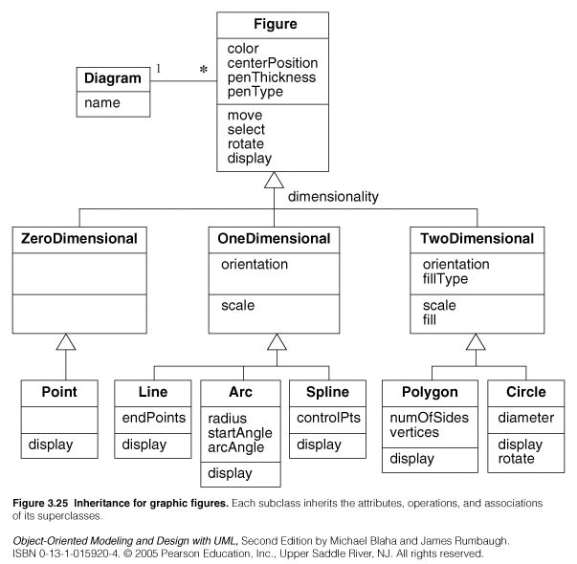

Slide 20
Use of generalization
Used for three purposes:
Support of polymorphism:
polymorphism increases the flexibility of software.
Adding a new subclass and automatically inheriting superclass behavior.
Structuring the description of objects:
Forming a taxonomy (classification), organizing objects according to their similarities.
It is much more profound than modeling each class individually and in isolation of other similar classes.
Enabling code reuse:
Reuse is more productive than repeatedly writing code from scratch.

Slide 21
Association Relationships
7COM1025 Programming for Software Engineers
If two classes in a model need to communicate with each other, there must be a link between them.
An association denotes that link.
Student
Instructor

Slide 22
Association Relationships (Cont’d)
7COM1025 Programming for Software Engineers
We can indicate the multiplicity of an association by adding multiplicity adornments to the line denoting the association.
The example indicates that a Student has one or more Instructors:
Student
Instructor
1..*

Slide 23
Association Relationships (Cont’d)
7COM1025 Programming for Software Engineers
The example indicates that every Instructor has one or more Students:
Student
Instructor
1..*

Slide 24
Association Relationships (Cont’d)
7COM1025 Programming for Software Engineers
We can also indicate the behavior of an object in an association (i.e., the role of an object) using rolenames.
teaches
learns from
Student
Instructor
1..*
1..*

Slide 25
Association Relationships (Cont’d)
7COM1025 Programming for Software Engineers
We can also name the association.
membership
Student
Team
1..*
1..*

Slide 26
Association Relationships (Cont’d)
7COM1025 Programming for Software Engineers
We can specify dual associations.
member of
Student
Team
1..*
1..*
1
president of
1..*

Slide 27
Association Relationships (Cont’d)
7COM1025 Programming for Software Engineers
We can constrain the association relationship by defining the navigability of the association. Here, a Router object requests services from a DNS object by sending messages to (invoking the operations of) the server. The direction of the association indicates that the server has no knowledge of the Router.
Router
DomainNameServer

Slide 28
Association Relationships (Cont’d)
7COM1025 Programming for Software Engineers
Associations can also be objects themselves, called link classes or an association class.
Registration
modelNumber
serialNumber
warrentyCode
Product
Warranty

Slide 29
Aggregation
7COM1025 Programming for Software Engineers
We can model objects that contain other objects by way of special associations called aggregations and compositions.
An aggregation specifies a whole-part relationship between an aggregate (a whole) and a constituent part, where the part can exist independently from the aggregate. Aggregations are denoted by a hollow-diamond adornment on the association.
Car
Engine
Transmission

Slide 30
Aggregation
Aggregation is a transitive relation:
if A is a part of B and B is a part of C then A is also a part of C
Aggregation is an antisymmetric relation:
If A is a part of B then B is not a part of A.

Slide 31
Aggregation versus Association
Aggregation is a special form of association, not an independent concept.
Aggregation adds semantic connotations:
If two objects are tightly bound by a part-whole relationship it is an aggregation.
If the two objects are usually considered as independent, even though they may often be linked, it is an association.ِ

Slide 32
Composition
7COM1025 Programming for Software Engineers
A composition indicates a strong ownership and coincident lifetime of parts by the whole (i.e., they live and die as a whole). Compositions are denoted by a filled-diamond adornment on the association.
Window
Scrollbar
1
1
Titlebar
1
1
Menu
1
1 .. *

Slide 33
Aggregation versus Composition
Composition is a form of aggregation with additional constraints:
A constituent part can belong to at most one assembly (whole).
it has a coincident lifetime with the assembly.
Deletion of an assembly object triggers automatically a deletion of all constituent objects via composition.
Composition implies ownership of the parts by the whole.
Parts cannot be shared by different wholes.

Slide 34
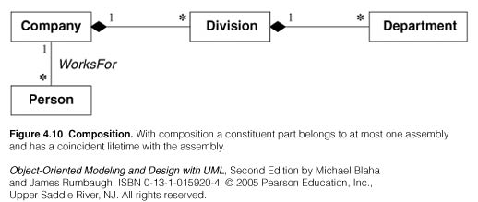

Slide 35
From Problem Statement To Object Model
Problem Statement: A stock exchange lists many companies. Each company is uniquely identified by a ticker symbol
Class Diagram:
StockExchange
*
*
Company
Lists
tickerSymbol

Slide 36
From Problem Statement to Code
Problem Statement :
A
stock exchange lists many companies.
Each company is identified by a ticker Symbol
Class Diagram:
*
*
Company
StockExchange
Lists
tickerSymbol
Java Code
public class StockExchange
{
private Vector m_Company = new Vector();
};
public class Company
{
public int m_tickerSymbol;
private Vector m_StockExchange = new Vector();
};

Slide 37
Practice Object Modeling: Iterate, Categorize!
Account
Bank
Customer
*
Amount
*
Name
AccountId
Has
Name
CustomerId
AccountId
Deposit()
Withdraw()
GetBalance()
CustomerId()
Savings
Account
Checking
Account
Mortgage
Account
Withdraw()
Withdraw()
Withdraw()

Slide 38
Interfaces
7COM1025 Programming for Software Engineers
An interface is a named set of operations that specifies the behavior of objects without showing their inner structure. It can be rendered in the model by a one- or two-compartment rectangle, with the stereotype <<interface>> above the interface name.
<<interface>>
ControlPanel

Slide 39
Interface
7COM1025 Programming for Software Engineers
<<interface>>
ControlPanel
Interfaces do not get instantiated. They have no attributes or state. Rather, they specify the services offered by a related class.
getChoices : Choice[]
makeChoice (c : Choice)
getSelection : Selection

Slide 40
Interface Realization Relationship
7COM1025 Programming for Software Engineers
<<interface>>
ControlPanel
A realization relationship connects a class with an interface that supplies its behavioral specification.
It is rendered by a dashed line with a hollow triangle towards the specifier.
specifier
implementation
VendingMachine

Slide 41
Packages
7COM1025 Programming for Software Engineers
A package is a container-like element for organizing other elements into groups.
A package can contain classes and other packages and diagrams.
Packages can be used to provide controlled access between classes in different packages.
Compiler

Slide 42
Packages (Cont’d)
7COM1025 Programming for Software Engineers
Classes in the FrontEnd package and classes in the BackEnd package cannot access each other in this diagram.
Compiler
FrontEnd
BackEnd

Slide 43
Packages (Cont’d)
7COM1025 Programming for Software Engineers
Classes in the BackEnd package now have access to the classes in the FrontEnd package.
Compiler
FrontEnd
BackEnd

Slide 44
Packages (Cont’d)
7COM1025 Programming for Software Engineers
Compiler
We can model generalizations and dependencies between packages.
JavaCompiler
Java

Slide 45
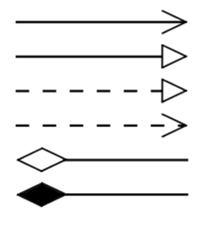
Summary of symbols

Slide 46
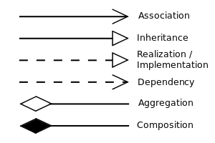
Summary of symbols

Slide 47
UML Summary
UML provides a wide variety of notations for representing many aspects of software development
Powerful, but complex language
Can be misused to generate unreadable models
Can be misunderstood when using too many exotic features
Object model: class diagram

Slide 48
Testing and Debugging

Slide 49
Program Errors
Compiler errors (syntax errors)
Runtime errors
Logic errors

Slide 50
Compiler Errors
Syntax error
Error in usage of Java
Detected by the compiler
A program with compilation errors cannot be run
Syntax warning
Warning message generated by the compiler
The program can be run
Very common (but sometimes hard to understand). Examples of syntax errors:
Forgetting a semicolon
Leaving out a closing bracket }
Redeclaring a variable
Others?

Slide 51
Compiler Errors
Hints to help find/fix compiler errors:
Compiler errors are cumulative: when you fix one, others may go away
Read the error messages issued by the compiler!
Realize that the error messages from the compiler are often (seemingly) not very helpful
The compiler does not know what you intended to do, it merely scans the Java code

Slide 52
Runtime Errors
Runtime error: program runs but gets an exception error message
Program may be terminated
Runtime errors can be caused by
Program bugs
Bad or unexpected input
Hardware or software problems in the computer system

Slide 53
Runtime Errors
Very common runtime errors are:
null reference (NullPointerException)
no object is referenced by the reference variable, i.e. it has the value null
array index out of bounds (ArrayIndexOutOfBoundsException)
Running out of memory
e.g. from creating a new object every time through an infinite loop

Slide 54
Runtime Errors
Hints to help find/fix runtime errors:
Check the exception message for the method and line number from which it came
Note that the line in the code that caused the exception may not be the line with the error
Example: consider the code segment
int [] nums = new int[10]; for (int j=0; j<=10; j++) nums[j] = j;
The exception will be at the line nums[j] = j; but the error is in the previous line

Slide 55
Logic Errors
Logic error: program runs but results are not correct Logic errors can be caused by:
incorrect algorithms
Very common logic errors are:
using == instead of the equals method
infinite loops
misunderstanding of operator precedence
starting or ending at the wrong index of an array
If index is invalid, you would get an exception
misplaced parentheses (so code is either inside a block when it shouldn’t be, or vice versa)

Slide 56
Logic Errors
Be careful of where you declare variables!
Keep in mind the scope of variables
Instance variables?
Formal parameters?
Local variables?
Example:
private int numStudents; // an attribute, to be initialized in some method
… public void someMethod(){ int numStudents = …; // not the attribute!
…
}

Slide 57
Testing vs Debugging
Testing: to identify any problems before software is put to use
“Testing can show the presence of bugs but can never show their absence”.
Debugging: locating bugs and fixing them

Slide 58
Hints for Success
When writing code:
Understand the algorithm before you start coding!
Start small!
Write and test first simpler methods (e.g. getters, setters, toString)
Then write and test each of the more complex methods individually
Check your code first by a preliminary hand trace
Then try running it

Slide 59
Debugging Strategies
Add main method to the class
Add print statements to your code
How to Use the NetBeans Debugger for Java
https://www.youtube.com/watch?v=2Z9B8wYhKWw

Slide 60
Adding a main Method
Adding a main method to the class
Conventionally placed at the end of the class code, after all the other methods

Slide 61
Using Print Statements
Using print statements
Insert System.out.println() statements at key locations
To show values of significant variables
To show how far your code got before there was a problem
In the print statement, it’s a good idea to specify
The location of the trace (what method)
The variable name as well as its value

Slide 62
Debuggers
All Integrated Development Environments have an interactive debugger feature
You can single-step step through your code (one statement at a time)
You can see what is stored in variables
You can set breakpoints
You can “watch” a variable or expression during execution

Slide 63
Defensive Programming
Good programming practices that protect you from your own programming mistakes, as well as those of others
Assertions
Parameter Checking
Write robust programs
Include checking for exceptional conditions; try to think of situations that might reasonably happen, and check for them
Examples: files that don’t exist, bad input data
Generate appropriate error messages, and either allow the user to reenter the data or exit from the program

Slide 64
Assertions
As we program, we make many assumptions about the state of the program at each point in the code
A variable's value is in a particular range
A file exists, is writable, is open, etc.
Some data is sorted
A network connection to another machine was successfully opened
…
The correctness of our program depends on the validity of our assumptions
Faulty assumptions result in buggy, unreliable code

Slide 65
Assertions
int binarySearch(int[] data, int searchValue) {
// What assumptions are we making about the parameter values?
…
}
data != null
data is sorted
What happens if these assumptions are wrong?

Slide 66
Assertions
Assertions give us a way to make our assumptions explicit in the code
assert temperature > 32 && temperature < 212;
The parameter to assert is a boolean condition that should be true
assert condition;
If the condition is false, Java throws an AssertionError, which crashes the program

Slide 67
Assertions
int binarySearch(int[] data, int searchValue) {
assert data != null;
assert isSorted(data);
…
}
String[] someMethod(int y, int z) {
assert z != 0;
int x = y / z;
assert x > 0 && x < 1024;
return new String[x];
}

Slide 68
Assertions
Assertions are little test cases sprinkled throughout your code that alert you when one of your assumptions is wrong
This is a powerful tool for avoiding and finding bugs
Assertions are usually disabled in released software
In Java, assertions are DISABLED by default
You can enable them

Slide 69
Assertions
Alternate form of assert
assert condition : expression;
If condition is false, expression is passed to the constructor of the thrown AssertionError
int binarySearch(int[] data, int searchValue) {
assert data != null : ”binary search data is null”;
assert isSorted(data) : ”binary search data is not sorted”;
…
}
String[] someMethod(int y, int z) {
assert z != 0 : ”invalid z value”;
int x = y / z;
assert x > 0 && x < 1024 : x;
return new String[x];
}

Slide 70
Assertions
If one of my assumptions is wrong, shouldn't I throw an exception?
No. You should fix the bug, not throw an exception.

Slide 71
Parameter Checking
Another important defensive programming
A method or function should always check its input parameters to ensure that they are valid
If they are invalid, it should indicate that an error has occurred rather than proceeding
This prevents errors from propagating through the code before they are detected
By detecting the error close to the place in the code where it originally occurred, debugging is greatly simplified

Slide 72
Parameter Checking
Two ways to check parameter values
assertions
if statement that throws exception if parameter is invalid
int binarySearch(int[] data, int searchValue) {
assert data != null;
assert isSorted(data);
…
}
int binarySearch(int[] data, int searchValue) {
if (data == null || !isSorted(data)) {
throw new InvalidArgumentException();
}
…
}

Slide 73
Parameter Checking
Should I use assertions or if/throw to check parameters?
If you have control over the calling code, use assertions
If parameter is invalid, you can fix the calling code
If you don't have control over the calling code, throw exceptions
e.g., your product might be a class library that is called by code you don’t control

Slide 74
Exception-throwing Principles
A special language feature - exceptions are objects but are associated with special language syntax (throw, throws, try, catch, finally)
No ‘special’ return value needed.
Errors cannot be ignored in the client.
Specific recovery actions are encouraged.
74
Notes:
74
Program Design
74

Slide 75
What is an exception?
An exception is an error condition that changes the normal flow of control in a program
Exceptions in Java separates error handling from main business logic
From very unusual (e.g. out of memory), to more common ones your program should check itself (e.g. index out of bounds)
From Java run-time system errors (e.g., divide by zero), to errors that programmers detect and raise deliberately

Slide 76
Throwing and catching
An error can throw an exception
throw <exception object>;
By default, exceptions result in the thread terminating after printing an error message
However, exception handlers can catch specified exceptions and recover from error
catch (<exception type> e) {
//statements that handle the exception
}

Slide 77
Throwing an Exception (i)
Example creates a subclass of Exception and throws an exception:
class MyException extends Exception { }
class MyClass {
void oops()
{ if (/* no error occurred */)
{ /* normal processing */ }
else { /* error occurred */
throw new MyException();
}
} //oops
}//class MyClass

Slide 78
Throwing an Exception (ii)
public void lendBook(Book b, Member m) throws Exception {
if (availableBooks.contains (b))
{
availableBooks.remove (b);
m.loanBook (b);
}
else {
throw new Exception ("Book not available.");
}
}
78
Notes:
78
Program Design
78

Slide 79
Exceptional flow of control
Exceptions break the normal flow of control.
When an exception occurs, the statement that would normally execute next is not executed.
What happens instead depends on:
whether the exception is caught,
where it is caught,
what statements are executed in the ‘catch block’,
and whether you have a ‘finally block’.

Slide 80
Approaches to handling an exception
Prevent the exception from happening
Catch it in the method in which it occurs, and either
Fix up the problem and resume normal execution
Rethrow it
Throw a different exception
Declare that the method throws the exception
With 1. and 2.a. the caller never knows there was an error.
With 2.b., 2.c., and 3., if the caller does not handle the exception, the program will terminate and display a stack trace

Slide 81
Java Exceptions are Objects
(try… catch…)
Java organizes exceptions in inheritance tree:
81
Notes:
81
Program Design
81

Slide 82
Error and RuntimeException
Error
“unchecked”, thus need not be in ‘throws’ clause
Serious system problems (e.g. ThreadDeath, OutOfMemoryError)
It’s very unlikely that the program will be able to recover, so generally you should NOT catch these.
RuntimeException
“unchecked”, thus need not be in ‘throws’ clause
Also can occur almost anywhere, e.g. ArithmeticException, NullPointerException, IndexOutOfBoundsException
Try to prevent them from happening in the first place!

Slide 83
Checked Exceptions
Checked exceptions are meant to be caught
for error situations that we anticipate
The compiler ensures that their use is tightly controlled.
throw instruction must be in try…catch… block in supplier….
Or method must state that it throws the exception - which the client must catch
Used properly, failures may be recoverable.
83
Notes:
83
Program Design
83

Slide 84
Describe differences between checked and unchecked exceptions
Checked Exceptions
• subclass of Exception
• must be handled by programmer (either with try-catch block or declared in method signature as thrown)
Unchecked Exceptions
• subclass of RuntimeException
• program will compile without explicit handling of unchecked exceptions

Slide 85
Declaring an exception type
Inherit from an existing exception type.
Provide a default constructor
and a constructor with one arg, type String.
Both should call super(astring);
Example:
class MyThrowable extends Throwable {
// checked exception
MyThrowable () {
super ("Generated MyThrowable");
}
MyThrowable (String s) { super (s); }
}

Slide 86
Exceptions are ubiquitous in Java
Exception handling required for all read methods
Also many other system methods
If you use one of Java's built in class methods and it throws an exception, you must catch it (i.e., surround it in a try/catch block) or rethrow it, or you will get a compile time error:
char ch; try
{ ch = (char) System.in.read(); }
catch (IOException e)
{
System.err.println(e);
return;
}

Slide 87
try…catch block (i)
try{
statement1;//any statement may throw exception
statement2;
statement3;
}catch (Exception e) {
System.out.println (e.getMessage());
}
finally{
do whatever else needs to be done here
}
87
Notes:
87
Program Design
87

Slide 88
Finally
The last part of the exception handling mechanism
is executed regardless of whether the exception is thrown or not
Often use to close resources (eg file)
flow of control if exception not thrown:
try block, finally block
flow of control when exception is thrown:
try, catch, finally

Slide 89
try…catch block (ii)
1. Exception thrown from here
try{
addressbook.saveToFile(filename);
tryAgain = false;
}
catch(IOException e) {
System.out.println("Unable to save to " + filename);
tryAgain = true;
}
2. Control transfers to here
89
Notes:
89
Program Design
89

Slide 90
Catch processing
When an exception occurs, the nested try/catch statements are searched for a catch parameter matching the exception class
A parameter is said to match the exception if it:
is the same class as the exception; or
is a superclass of the exception; or
if the parameter is an interface, the exception class implements the interface.
The first try/catch statement that has a parameter that matches the exception has its catch statement executed.
After the catch statement executes, execution resumes with the finally statement, then the statements after the try/catch statement.

Slide 91
The throws clause
If a method throws an exception and does not catch it, it must say so by a throws clause in its signature.
Exception is then thrown in calling method…
(which may call method in try…catch… block, or...)
public void saveToFile (String destinationFile) throws IOException{
-- code including a 'throw'
}
91
Notes:
91
Program Design
91

Slide 92
Catch or Specify
A method must either catch or specify all checked exceptions that can be thrown within its body, i.e.
Those that it explicitly throws
Those thrown (and not “caught”) by another method that it calls
Exception that can be thrown by a method is part of the method's contract/public programming interface
Callers (clients) of a method must know about the exceptions that a method can throw in order to decide what to do
92
Notes:
92
Program Design
92

Slide 93
Catching multiple exceptions
try {
...
ref.process();
...
}
catch(EOFException e) {
// Take action on end-of-file exception.
...
}
catch(FileNotFoundException e) {
// Take action on file-not-found exception.
...
}
Order matters - put most general (in terms of inheritance) exception last.
93
Notes:
93
Program Design
93

Slide 94
Defining new exceptions
New types of exception can be defined
Extend Exception or RuntimeException.
Only extend RuntimeException if you want an unchecked exception
Define new types to give better diagnostics
Include reporting and/or recovery information.
94
Notes:
94
Program Design
94

Slide 95
Writing your own exception
Extending Exception to write your own exception class
public class MarkException extends Exception{ private int mark;
public MarkException (int m)
{
super (m + " is not a valid mark.");
mark = m;
}
}
Scenario: might be processing marks from Student objects or getting entry from a User

Slide 96
Using your own exception
would be inside some method
public void processMarks(int mark) throws MarkException
{
if (mark < 0 || mark > 100) throw
new MarkException (mark);
}
call of method would be in try/catch block
try{
ss.processMarks(55);
}catch (MarkException me){
System.out.println(me);
}

Slide 97
Attempting Recovery (i)
Typically just printing out an exception is not useful
It is a mechanism for dealing with potential problems
public int getValue() {
boolean ok = false;
int value = 0;
String valueAsString = null;
while (!ok) {
try {
valueAsString = br.readLine();
value = Integer.parseInt (valueAsString);
ok = true;
}
catch (NumberFormatException e){
System.out.print (valueAsString +
" is not a proper number. Try again: ");
}
catch (IOException e) {System.out.println (e);}
}
return value;
}
97
Notes:
97
Program Design
97

Slide 98
Attempting recovery (ii)
// Try to save the address book.
boolean successful = false;
int attempts = 0;
while(!successful && attempts < MAX_ATTEMPTS) {
try {
addressbook.saveToFile(filename);
successful = true;
}
catch(IOException e) {
System.out.println("Unable to save to " + filename);
attempts++;
if(attempts < MAX_ATTEMPTS) {
filename = an alternative file name;
}
}
}
if(!successful) {
Report the problem and give up;
}
98
Notes:
98
Program Design
98

